Slide 1
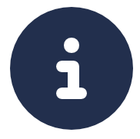
Hover over the “Info circle” icon to get help and additional information throughout the App!

Slide 2
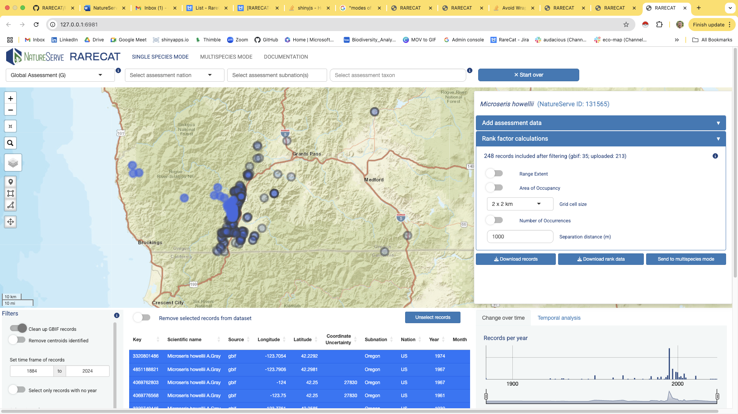
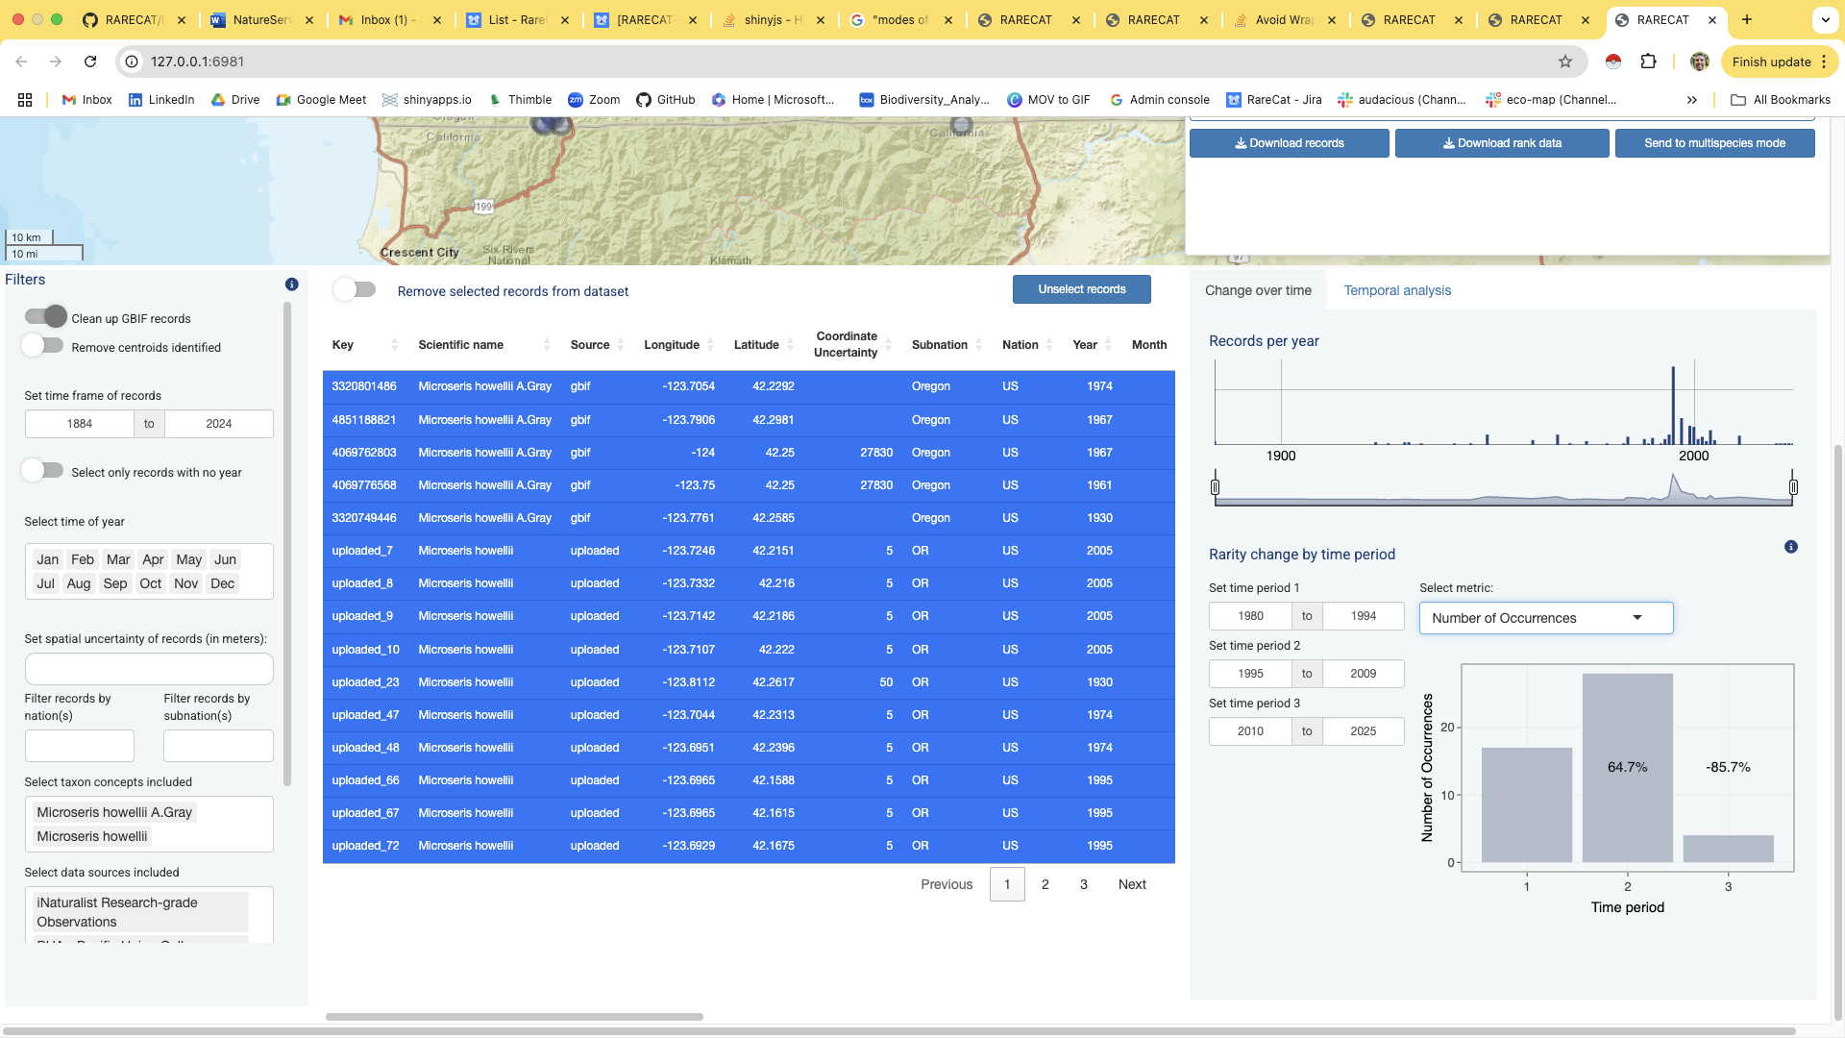
1
3
2
4
5
6

Slide 3
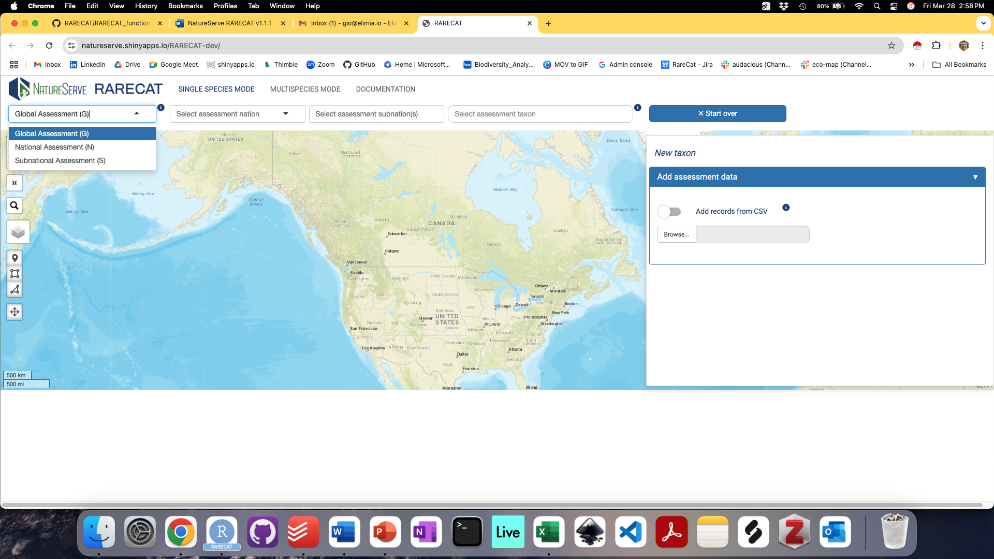
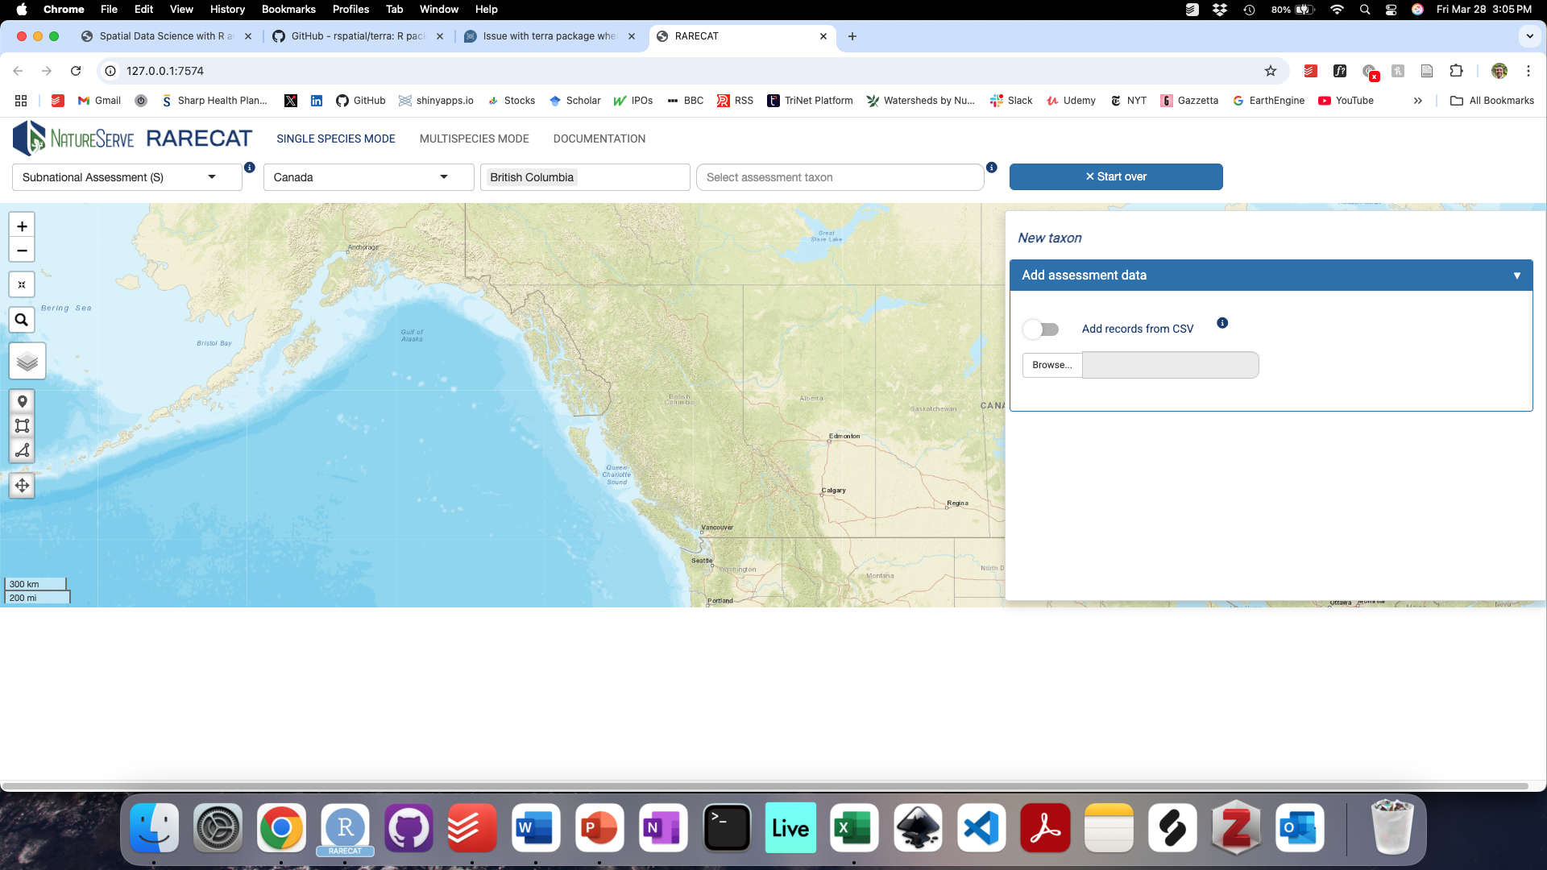

Slide 4
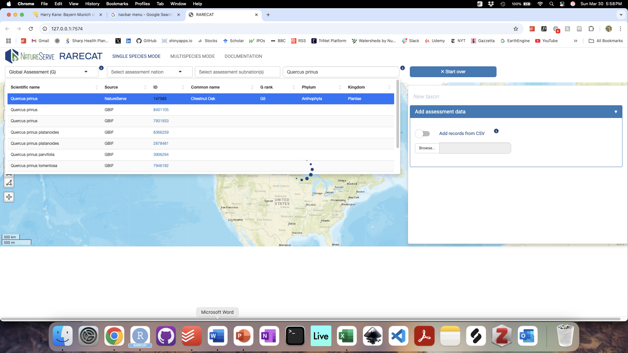
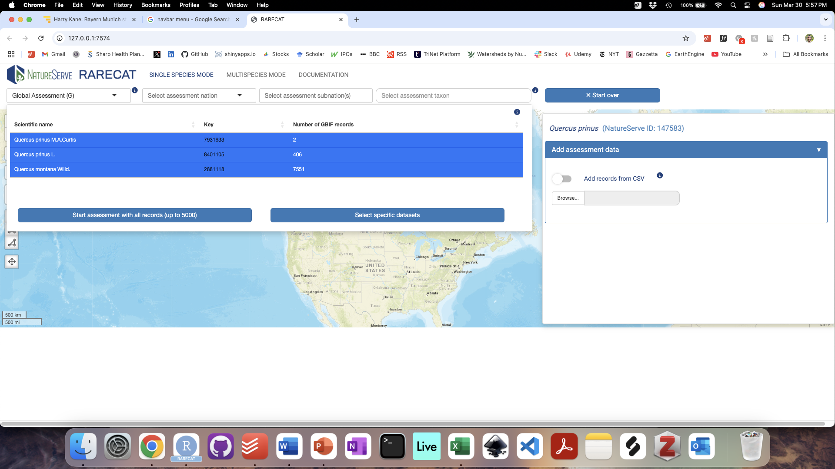
A)
B)

Slide 5
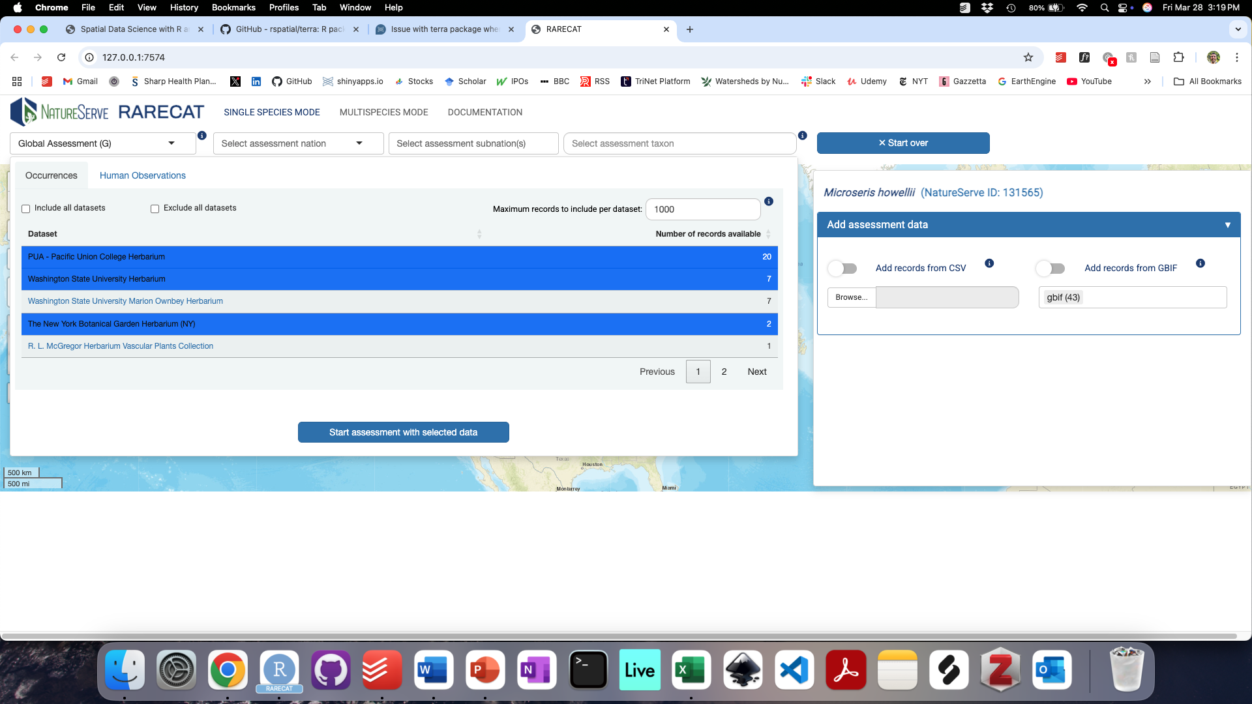
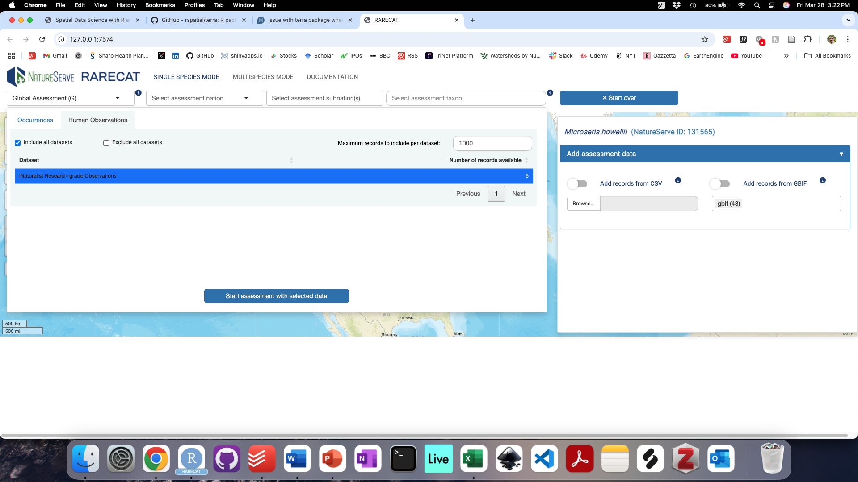
A)
B)

Slide 6
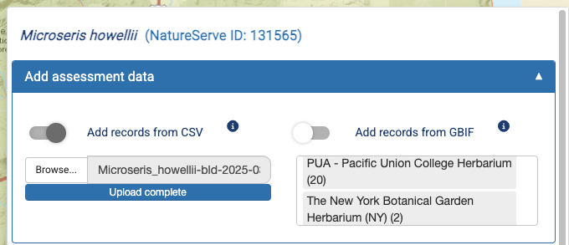

Slide 7
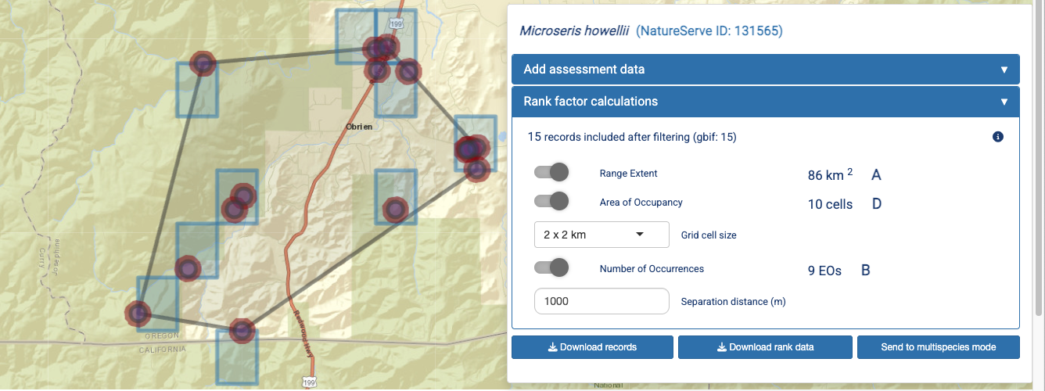

Slide 8
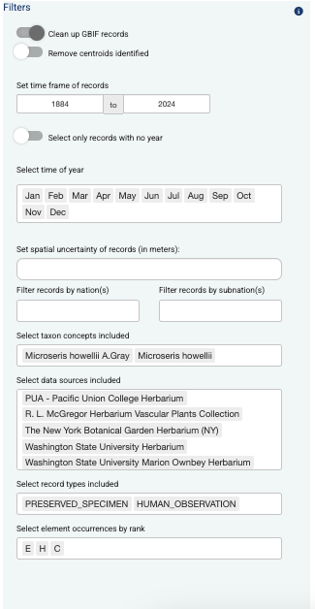
Apply filter to remove GBIF records identified as jurisdiction centroids
Apply default filters to clean up uploaded GBIF records
Limit Rank Assessment to specific time frame; defaults to year of first record and year of last record as start and end years, respectively
Select the level of maximum spatial uncertainty in meters (i.e. DarwinCore field “coordinateUncertaintyInMeters”) for inclusion of records; defaults to NULL, i.e. all records are included. Records for which spatial uncertainty in meters is unavailable are always included in the filtered dataset
Select all records with no known year so they can be assessed from Map and Records Table
Limit Rank Assessment to records collected in specific months across all years included
Limit Rank Assessment to the US or Canada; defaults to all nations for which records are available
Limit Rank Assessment to one or more of NatureServe’s subnational entities (i.e. US States/territories and/or Canadian provinces; defaults to all subnations for which records are available)
Limit Rank Assessment to one or more identified taxon concepts for the selected target taxon; defaults to all taxon concepts for which records have been added
Filter records by data source; defaults to all data sources which have been used to add records to the Rank Assessment
Filter records by basis of record (i.e. DarwinCore field “basisOfRecord”); defaults to all data sources which have been used to add records to the Rank Assessment
If uploaded records have populated EO Rank values, filter those records by respective EO Rank; defaults to all records being included and records with no value for EO Rank are always included

Slide 9
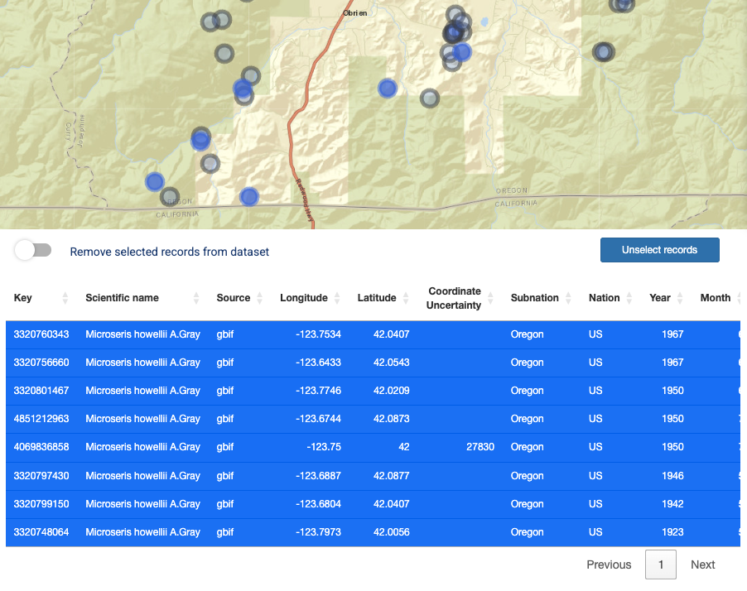

Slide 10
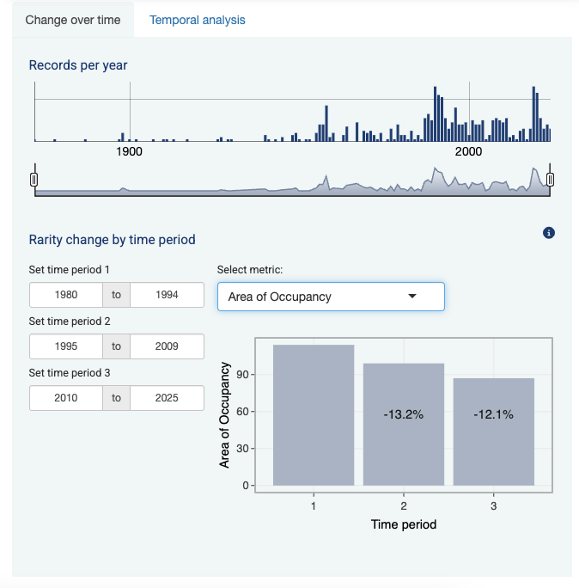

Slide 11
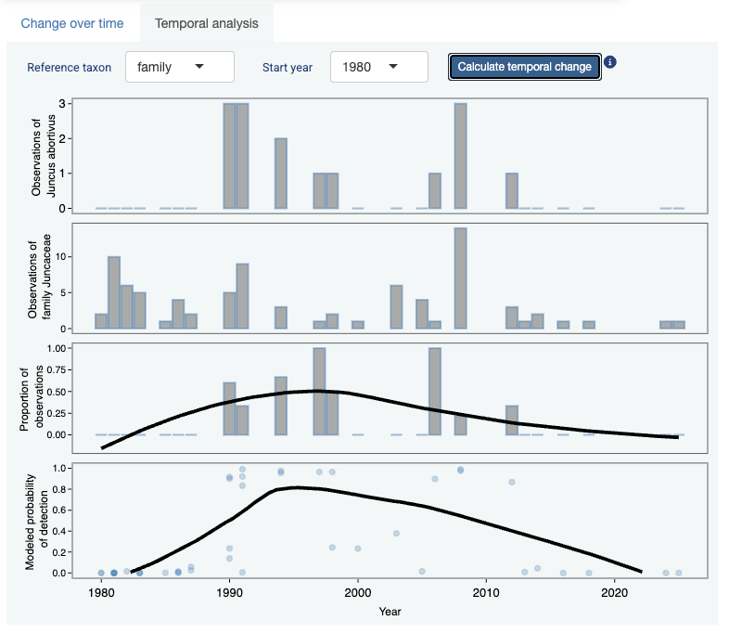

Slide 12
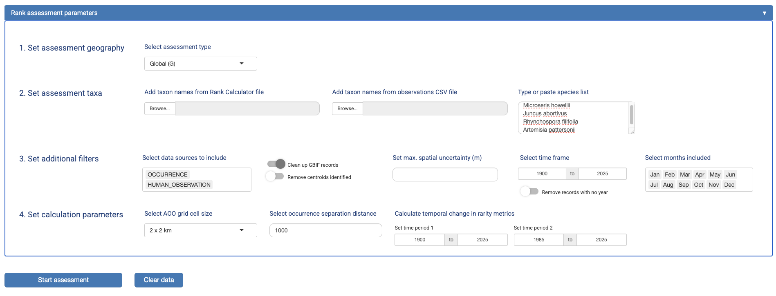

Slide 13
